Slide 1
Building Machine Learning Models in AWS
using New York Taxi Data
DSBA 6190: Spring 2021 (ML1)
Team Members
Alvis Chung | Rikitha Muddana | Tristan Richard
Shree Bhattarai | Sonal Verma | Parvinder Tomar

Slide 2
What were we trying to build?
A logistic regression model that predicts whether a trip occurred during day or night ( 6 AM - 6 PM: Day)
A linear regression model that predicts trip time based on drop-off and pickup location.
How does the Raw Data look like?
Summary
Features
lpep_pickup_datetime
lpep_dropoff_datetime
PULocationID
DOLocationID
passenger_count
trip_distance
extra
mta_tax
Tip_amount
Tolls_amount
improvement_surcharge
total_amount
payment_type
trip_type
2016-2019
Size ~ 30 GB
Monthly CSVs for ‘Yellow’ and ‘Green’ cab

Slide 3
Feature Engineering Performed
Used pickup_datetime to create a Boolean feature ‘Day’
Subtracted pickup_datetime from dropoff_datetime to create a feature “trip_duration” (in Minutes)
Utilized Calendar module to create a Boolean feature “Weekdays” based on pickup_datetime
Created a dictionary of National holidays and mapped the pickup_datetime to create a new boolean feature “Holidays”
Added a categorical feature “color” to flag whether the data was from green or yellow taxi cab.
Merged the two taxi types into a single giant CSV and stored it in S3

Slide 4
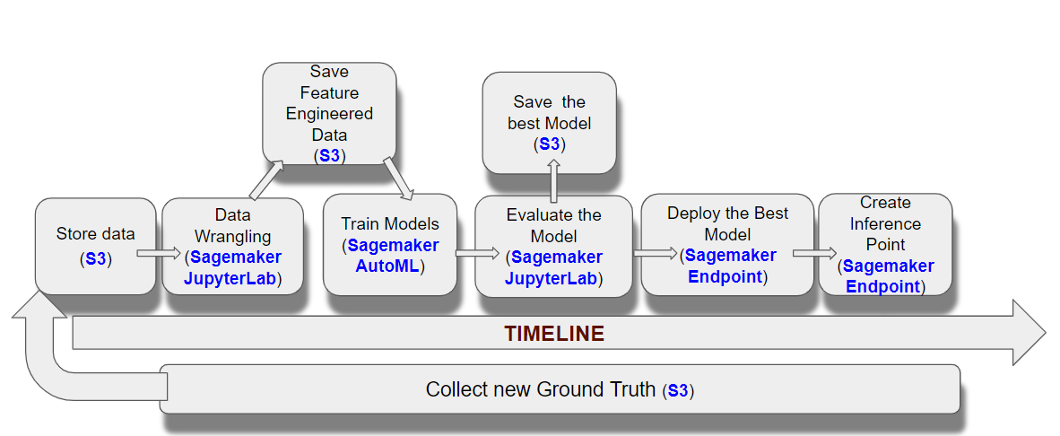
Overall Job Workflow
We randomly selected 1GB of data to train,test and deploy our Models
70% Train, 15% Validation and 15% Test

Slide 5
Model Observability
What happens in case of failures due to power outages on a rainy day or system failures or delay due to heavy traffic?
Amazon has a service that can help deal with the problem of system failures:
Amazon Cloud Watch Alarm
Can be used to monitor and recover Sagemaker in case of failure.
The automate recovery process alerts us when system fails due to any reason.
It activates for upto three failures per day to keep track of the failure status.
How to ensure the system performs well in case of high prediction requests or delays due to incoming traffic?
The system should be able to scale to make predictions quickly
We may have to upgrade the compute power as well as create more instances at endpoints depending on the incoming traffic. This will ensure the system works well at times of delays.

Slide 6
How to version control your code?
Version control, also called source control, allows to manage changes to files over time, storing these modifications in a database.
It is important to keep track of changes and keep every team member working off the latest version.
One of the ways to version control in Sagemaker is:
Git-Based version control systems
Git repositories are added to the Jupyter Notebook to coauthor projects, track code changes, and amalgamate software engineering and data science practices for production-ready code management.
Storing notebooks in a Git repository enables one to decouple Jupyter Notebooks from the instance lifecycle and keep them as standalone documents, which can be referenced and reused in the future.

Slide 7
Cost Drivers for the Model Building
Key Cost Drivers:
Cost of data
Cost of model building including research/analysis, training & test
Personnel cost
Cost of production including prediction, operations/monitoring and maintenance
Areas of Cost Uncertainty:
Cost of error
Data quality
Cost of running instances at the endpoint depending on incoming traffic

Slide 8
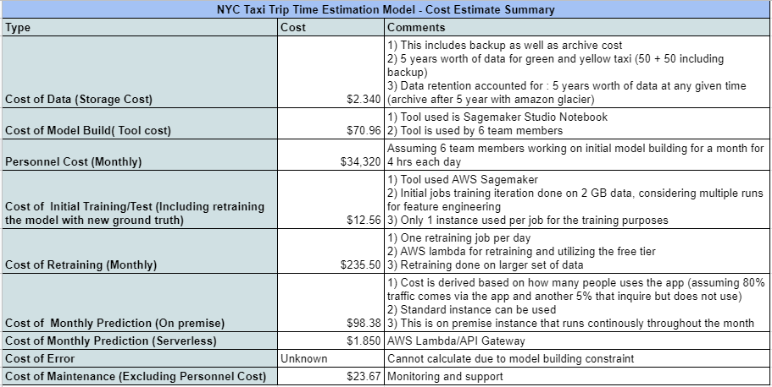
Cost Estimates for the Model Building
Refer Appendix or Project report for detail cost calculations

Slide 9
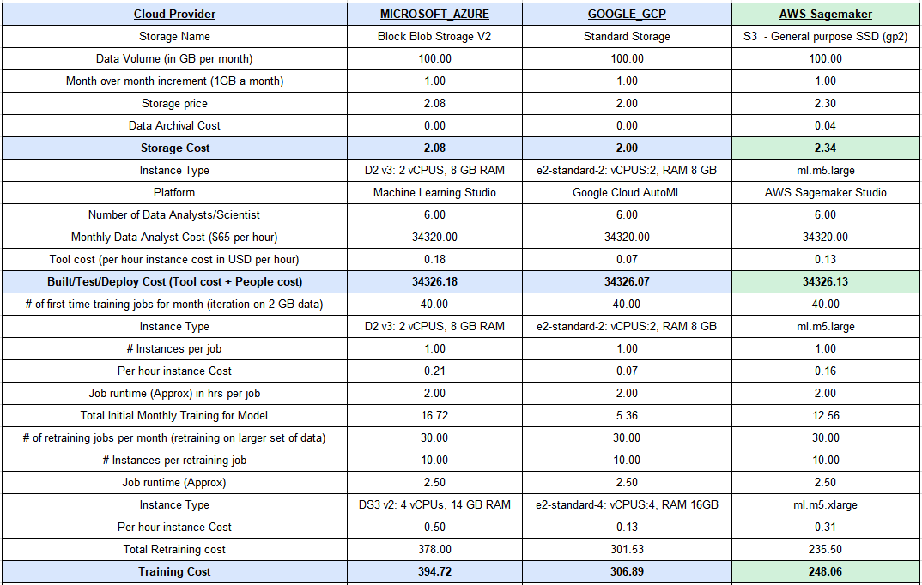
Alternate Cloud Platform
Price Comparison with Microsoft Azure and GCP

Slide 10
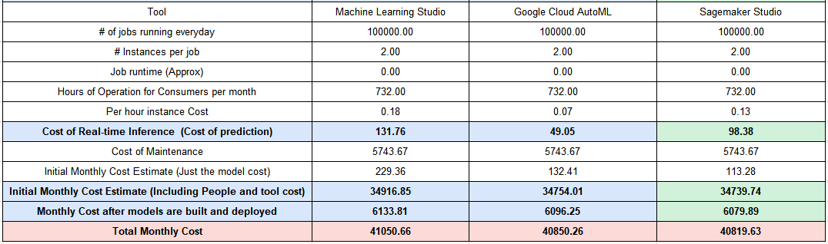
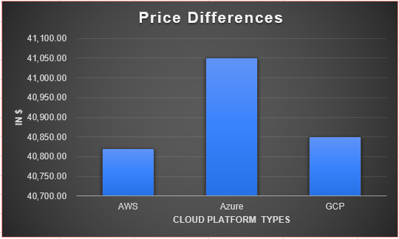


Alternate Cloud Platform

Slide 11
Conclusion & Recommendations
Looking back on the design now we could have added in or changed:
Include another variable for determining what season the trip occurred
Using less people for model development and allocating that money elsewhere (around 85% of monthly cost is for salary)
Trying to use another cloud provider to see which provider is more user friendly to help developers
In conclusion we believe that we have developed a well thought out data collection, model design, cost estimate, and considered some alternative services
With this in place we know that we can implement all of this to create a product that taxi services can use to better the services they provide
Notes:
In New York the winter months will more than likely have longer trip times because of snow and road maintenance so with more time we would’ve liked to incorporate a seasonable variable
In our cost estimate we currently have 6 people working to develop the features and model, the salary cost monthly is around 34 thousand. Perhaps we could take a person or two off of the development of our model and use those freed up funds to develop a user friendly interface for consumers to use.
Also with more time we would’ve liked to try to use other cloud provider services, perhaps one of them might have been more user friendly for our developers. Especially since AWS has been having issues.
In conclusion we believe that we have developed a well thought out data collection, model design, cost estimate, and considered some alternatives for our services used. With all of this we know that we will be able to implement this design to create a useful tool for taxi services.

Slide 12
Trade Offs and Limitations
Compute: AWS educate account did not allow us to run faster instances. The fastest instance we could use was ml.m5.4xlarge (16 vCPU + 64 GiB).
Access: AWS access policies on Educate account were not enough during the project phase.
This resulted in increased cost as well as longer time to design, analyze and deploy the model.
Notes:
In New York the winter months will more than likely have longer trip times because of snow and road maintenance so with more time we would’ve liked to incorporate a seasonable variable
In our cost estimate we currently have 6 people working to develop the features and model, the salary cost monthly is around 34 thousand. Perhaps we could take a person or two off of the development of our model and use those freed up funds to develop a user friendly interface for consumers to use.
Also with more time we would’ve liked to try to use other cloud provider services, perhaps one of them might have been more user friendly for our developers. Especially since AWS has been having issues.
In conclusion we believe that we have developed a well thought out data collection, model design, cost estimate, and considered some alternatives for our services used. With all of this we know that we will be able to implement this design to create a useful tool for taxi services.

Slide 13
Questions
Notes:
In New York the winter months will more than likely have longer trip times because of snow and road maintenance so with more time we would’ve liked to incorporate a seasonable variable
In our cost estimate we currently have 6 people working to develop the features and model, the salary cost monthly is around 34 thousand. Perhaps we could take a person or two off of the development of our model and use those freed up funds to develop a user friendly interface for consumers to use.
Also with more time we would’ve liked to try to use other cloud provider services, perhaps one of them might have been more user friendly for our developers. Especially since AWS has been having issues.
In conclusion we believe that we have developed a well thought out data collection, model design, cost estimate, and considered some alternatives for our services used. With all of this we know that we will be able to implement this design to create a useful tool for taxi services.

Slide 14
Appendix
Topic | Reference
Serverless Endpoint | https://aws.amazon.com/blogs/machine-learning/build-a-serverless-frontend-for-an-amazon-sagemaker-endpoint/#:~:text=By%20combining%20this%20powerful%20platform,sources%2C%20and%20presents%20the%20resulting
Cloud_hacker_concern | https://www.washingtonpost.com/technology/2020/03/02/cloud-hack-problems/
Azure vs GCP Costs | https://docs.google.com/document/d/1BC1VJDuDsYSAopRd-CKqyYZeqDxNYFyYiZkz-GI1xe0/edit
Notes:
In New York the winter months will more than likely have longer trip times because of snow and road maintenance so with more time we would’ve liked to incorporate a seasonable variable.
In our cost estimate we currently have 6 people working to develop the features and model, the salary cost monthly is around 34 thousand. Perhaps we could take a person or two off of the development of our model and use those freed up funds to develop a user friendly interface for consumers to use.
Also with more time we would’ve liked to try to use other cloud provider services, perhaps one of them might have been more user friendly for our developers. Especially since AWS has been having issues.
In conclusion we believe that we have developed a well thought out data collection, model design, cost estimate, and considered some alternatives for our services used. With all of this we know that we will be able to implement this design to create a useful tool for taxi services.

Slide 15
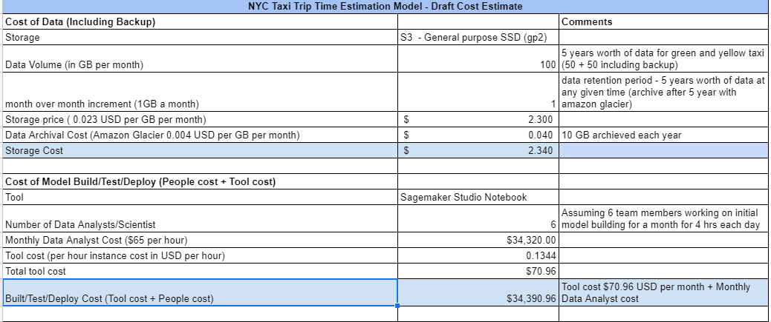
Appendix - Detail Cost Estimates
Notes:
In New York the winter months will more than likely have longer trip times because of snow and road maintenance so with more time we would’ve liked to incorporate a seasonable variable
In our cost estimate we currently have 6 people working to develop the features and model, the salary cost monthly is around 34 thousand. Perhaps we could take a person or two off of the development of our model and use those freed up funds to develop a user friendly interface for consumers to use.
Also with more time we would’ve liked to try to use other cloud provider services, perhaps one of them might have been more user friendly for our developers. Especially since AWS has been having issues.
In conclusion we believe that we have developed a well thought out data collection, model design, cost estimate, and considered some alternatives for our services used. With all of this we know that we will be able to implement this design to create a useful tool for taxi services.

Slide 16
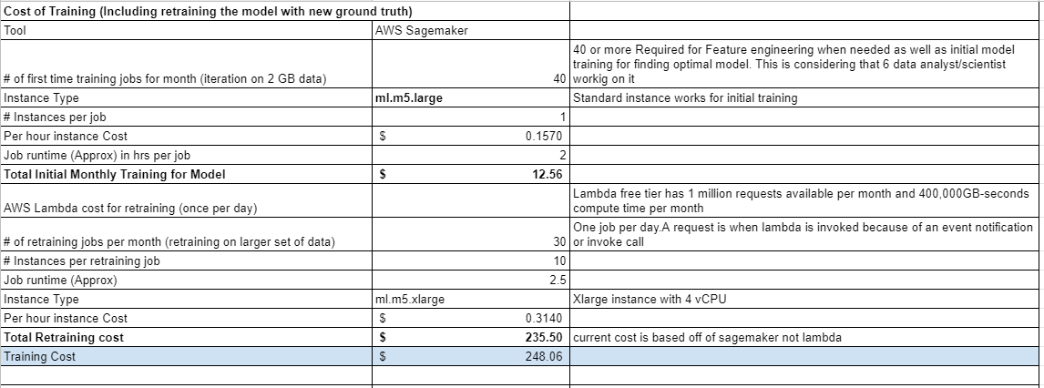
Appendix - Detail Cost Estimates
Notes:
In New York the winter months will more than likely have longer trip times because of snow and road maintenance so with more time we would’ve liked to incorporate a seasonable variable
In our cost estimate we currently have 6 people working to develop the features and model, the salary cost monthly is around 34 thousand. Perhaps we could take a person or two off of the development of our model and use those freed up funds to develop a user friendly interface for consumers to use.
Also with more time we would’ve liked to try to use other cloud provider services, perhaps one of them might have been more user friendly for our developers. Especially since AWS has been having issues.
In conclusion we believe that we have developed a well thought out data collection, model design, cost estimate, and considered some alternatives for our services used. With all of this we know that we will be able to implement this design to create a useful tool for taxi services.

Slide 17
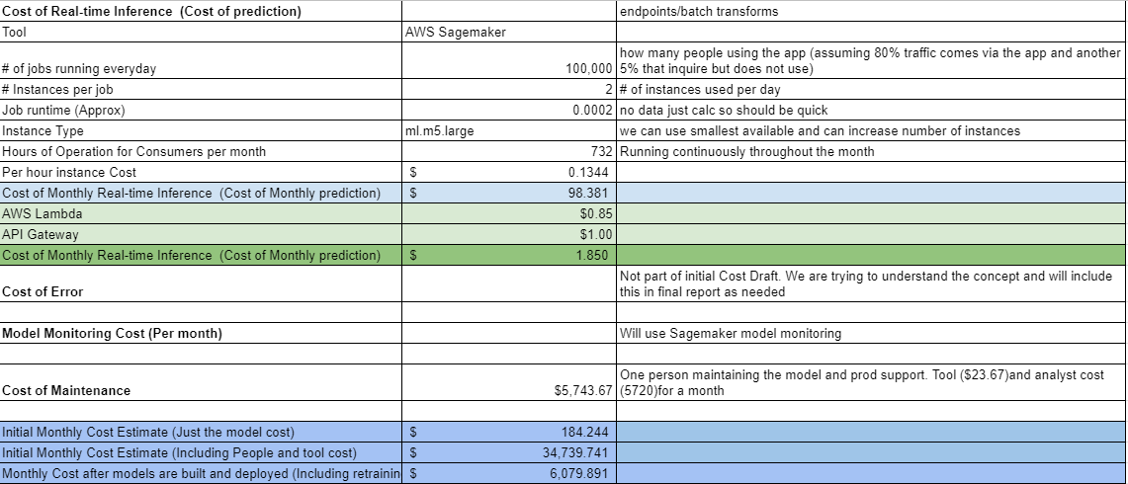
Appendix - Detail Cost Estimates
Notes:
In New York the winter months will more than likely have longer trip times because of snow and road maintenance so with more time we would’ve liked to incorporate a seasonable variable
In our cost estimate we currently have 6 people working to develop the features and model, the salary cost monthly is around 34 thousand. Perhaps we could take a person or two off of the development of our model and use those freed up funds to develop a user friendly interface for consumers to use.
Also with more time we would’ve liked to try to use other cloud provider services, perhaps one of them might have been more user friendly for our developers. Especially since AWS has been having issues.
In conclusion we believe that we have developed a well thought out data collection, model design, cost estimate, and considered some alternatives for our services used. With all of this we know that we will be able to implement this design to create a useful tool for taxi services.

